Slide 1
USE OF XPATH IN AUTOMATION
rosario, DECEMBER 2018

Slide 2
index
Introduction
Xpath on testing automation
Using XPath for locating elements in HTMl
Why do we need to master many XPath syntaxes?
Types of Xpath
Absolute Xpath
Relative Xpath
Exact Xpath
What should be considered when choosing an XPath?
Sample HTML code
Locating elements
with Known Attribute
with known Element and Attributes
with Known Visible Text (exact match)
when part of the visible text is known (partial match)
with Multiple Attributes
when starting visible text is known
with Dynamic Attribute values
Locating elements relative to known element
Locating family elements
Locating a parent element
Locating a child element
Locating ancestors of a known element
Locating following and preceding elements
Locating preceding and following sibling
Validating and extracting Xpath
XPath or CSS
Quick Reference
Terminology
References
Practicing Xpath

Slide 3
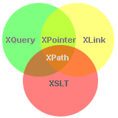
introduction
WHAT IS XPATH
XPath (XML Path Language) is a query language for selecting nodes from an XML document. In addition, XPath may be used to compute values (e.g., strings, numbers, or Boolean values) from the content of an XML document. XPath was defined by the World Wide Web Consortium (W3C)
Xpath was created to be used on the xslt standard, where it’s used to select and exam the structure of the input document of the transformation
XPath is a syntax for defining parts of an XML document
XPath uses path expressions to navigate in XML documents
XPath contains a library of standard functions
XPath is a major element in XSLT and in XQuery
XPath is a W3C recommendation

Slide 4
Xpath on testing automation
Learning and mastering a powerful location strategy is a MUST in Selenium test automation. CSS and XPath are the powerful location strategies as compared to the other options available such as ID, name, tagname, link, partialLink

Slide 5
Using XPath for locating elements in HTMl
XPath is for locating the elements or nodes in XML documents
XML and HTML has similar syntax (HTML is a subset of XML)
Hence XPath can be used to locate elements in HTML pages (web pages).
Notes:
See references on https://www.w3schools.com/xml/xml_xpath.asp

Slide 6
Why do we need to master many XPath syntaxes?
We may not be able to locate the elements directly using their unique attributes as some elements do not have unique attributes (id or name). Some attributes are dynamically changed. There could be elements without attributes. Hence we may have to locate them differently than the static elements.
XPATH CAN BE USED FOR:
Locating elements with respect to a known element
Locating elements with partially static attribute values
Locating elements without attributes or without unique attributes
XPath can do bidirectional navigation (Going forward and backward)
XPath is one of most flexible and strongest location strategy and can be used for locating an element in a web page.

Slide 7
Types of XPath
Absolute XPath
Relative XPath
Exact XPath
Absolute XPaths starts with the root of the HTML pages.
Absolute XPaths are not advisable for most of the time due to following reasons:
Absolute XPaths are lengthier and hence they are not readable
Absolute XPaths are brittle when minor structural changes are done to the web pages
Absolute XPaths shall be used only when a relative XPath cannot be constructed. (highly unlikely). Absolute XPaths tends to break as web pages/content is changed. Hence it is not recommended to use absolute XPath in Selenium.
Syntax: Absolute XPaths start with /html
Example: /html/body/div[1]/div/div[2]/form/div[2]/input
Relative XPaths is used for locating an element with respect to an element known as XPath. The element of your choice is referred relative to a known element.
Syntax: Relative XPaths are started with two forward slashes ‘//’.
Example: //div[@id=’divUsername’]/input
Locating elements using their attributes, values and inner text of the elements.
Example: @id=’divUsername’

Slide 8
What should be considered when choosing an XPath?
It is important to consider following while choosing an XPath from available options.
A good locator is:
XPath should have only one candidate element (Unique). It is easy to identify the element easily when the XPath is descriptive. It should be possible to locate the element with given XPath when a test is run again in subsequent releases. XPath should be selected in such a way it is valid even after changes in DOM. You will have multiple XPath options. A shorter XPath shall be selected to make it more readable.
Unique
Descriptive
Unlikely to change
Shorter in length
Valid even after changes to a page

Slide 9
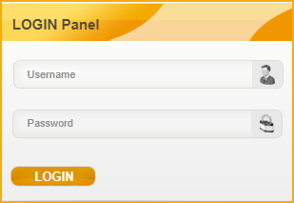
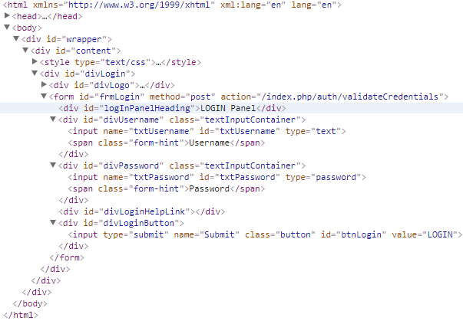
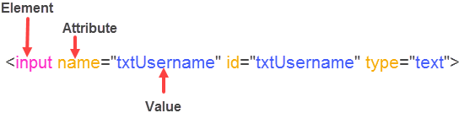
Sample HTML code
Following HTML will be used for the explaining XPath syntax.

Slide 10
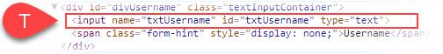
Locating elements
with Known Attribute
with known Element and Attributes
The following syntax can be used for locating elements when at least one of the attribute value is unique and static (not changed).
Syntax:
//*[@attributeName=’value’]
Let’s consider the username field
Examples:
//*[@id=’txtUsername’]
//*[@name=’txtUsername’]
//*[@type=’text’]
//elementName[@attributeName=’value’]
Examples :
//input[@id=’txtUsername’]
//input[@name=’txtUsername’]

Slide 11
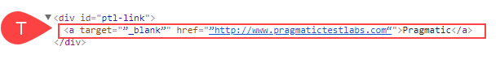
Locating elements
when part of the visible text is known (partial match)
with Known Visible Text (exact match)
Syntaxes :
//elementName[contains(text(),’part of the text’)]
//elementName[contains(.,’part of the text’)]
//*[contains(text(),’part of the text’)]
Examples :
//a[contains(text(),’Pragmatic’)]
//a[contains(., ‘Test Labs‘)]
//*[contains(text(), ‘Test Labs‘)]
Following syntax is used for locating elements containing exact text within an element.
//elementName[text()=’exact text’] or
/*[text()=’exact text’]
Let’s consider locating following element:
Examples :
//a[text()=’Pragmatic’]
//*[text()=’Pragmatic’]
Locating elements by the visible text is not advisable if you are testing a multilingual application and when same visible text is appearing in more than one location.

Slide 12
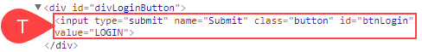
Locating elements
with Multiple Attributes
when starting visible text is known
Sometimes it may not be possible to locate an element with a single attribute. In the real world, we have a similar issue. We cannot locate a person by just first name or last name. We will have to use a combination of first name and last name to locate a person without making any confusion.
Syntax
//*[attribute1=’value1’][attribute2=’value2’]…[attributeN=’valueN’] or
//elementName[attribute1=’value1’][attribute2=’value2’]…[attributeN=’valueN’]
Examples :
//*[@id=’txtUsername’][@name=’txtUsername’]
//input[@class=’button’][@type=’submit’][@value=’LOGIN’][@name=’Submit’]
The following could be used when starting text of the innerHTML is static.
Syntax:
//elementName[starts-with(text(),’starting text’)] or
//*[starts-with(text(),’starting text’)]
Let’s consider locating following element:
Examples:
//a[starts-with(text(),’Pragmatic’)] or
//*[starts-with(text(),’Pragmatic’)]

Slide 13
Locating elements
with Dynamic Attribute values
Following syntax could be used when a part of the attribute values are NOT changed. We can use the non changing value for locating the element.
Syntax
//elementName[contains(@attributeName,’part of the value’)] or
//*[contains(@attributeName,’part of the value’)]
//elementName[starts-with(@attributeName,’fixed prefix of the value’)]
Examples :
//a[contains(@href,’pragmatic’)]
//*[contains(@href,’testlabs’)]
//a[starts-with(@href,’pragmatic’)]
The ends-with() function is part of XPath 2.0. Browsers generally only support 1.0 at the time of this writing. Hence ends-with is not included.

Slide 14
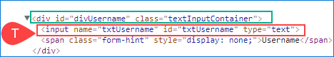
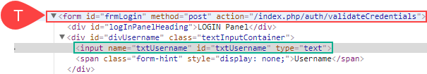
Locating family elements
Locating a parent element
Locating a child element
The parent axis contains the parent of the context node.
Syntax:
//<knownXpath>/parent::* or
//<knownXpath>/parent::elementName
XPath of the known element : //div[@id=’divUsername’].
Now we can locate the parent form element with respect to the div element
Examples:
//div[@id=’divUsername’]/parent::form.
//div[@id=’divUsername’]/parent::*
//div[@id=’divUsername’]/..
The child axis contains the children of the context node
Syntax:
//<xpathOfKnownElement>/child::<elementName> or
//<xpathOfKnownElement>/child::*
//<xpathOfKnownElement>/<elementName>
Examples:
Xpath of the known element //div[@id=’divUsername’]
//div[@id=’divUsername’]/child::input
//div[@id=’divUsername’]/input
You can use / instead of child:: from the XPath.

Slide 15
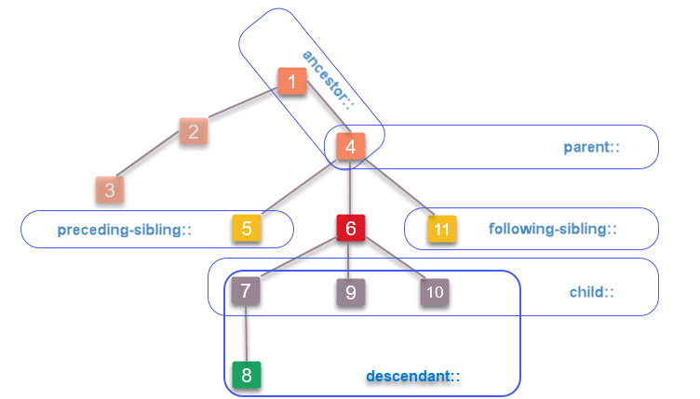
Locating elements relative to known element
If an element of our interest do not have a unique attribute(s) or innerHTML, we need to locate the element with respective to a known element with unique attribute(s) or innerHTML.
We do this very well in our real life. We always give direction to a new location with respective to an already known location (a landmark). Giving direction to your home from a well-known shop, statue, railway station etc.
XPath has thirteen (13) different axes. We will look into a subset of useful axes in this presentation.
Your target element should be closer to the known element to make XPath shorter and readable. This also will ensure your XPath is less likely to break when changes are done to the web page.

Slide 16
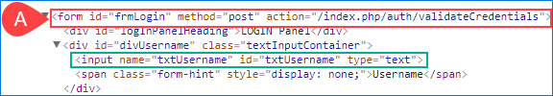
Locating ancestors of a known element
The ancestor axis contains the ancestors of the known element; ancestor axis consists of the parent of a known element and the parent’s parent so on.
Syntax:
//<xpathOfKnownElement>/ancestor::<elementName> or //<xpathOfKnownElement>/ancestor::*
Examples:
//input[@id=’txtUsername’]/ancestor::form : will select the form element
//input[@id=’txtUsername’]/ancestor::* : div element will be selected from the available candidates as it comes first in the path.

Slide 17
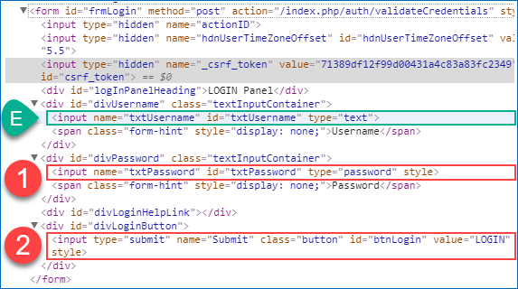
Locating following and preceding elements
following
Keyword following:: can be used for locating an element anywhere below the tree with respect to a known element.
Syntax:
//<xpathOfKnownElement>/following::<elementName> or
//<xpathOfKnownElement>/following::*
Examples:
//input[@id=’txtUsername’]/following::input
//input[@id=’txtUsername’]/following::*
There are two candidate elements. Any descendant elements after the first candidate in the path are excluded by Selenium.
To select the login button input element with respect to the username field.
//input[@id=’txtUsername’]/following::input[last()]

Slide 18
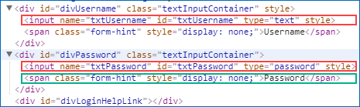
Locating following and preceding elements
preceding
Keyword preceding:: is used for locating an element before a known (xpath) element.
Syndax:
//<xpathOfKnownElement>/preceding::<elementName> or
//<xpathOfKnownElement>/preceding::*
Example :
//span[text()=’Password’]/preceding::input
There will be two candidate elements. Selenium will select the password input element. Elements are ordered from the context note (span) with the known XPath.
//span[text()=’Password’]/preceding::input[2] can be used for selecting the username field.

Slide 19
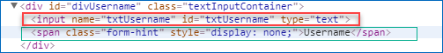
Locating preceding and following sibling
preceding
Keyword preceding-sibling:: is used to selects the sibling(s) that comes before the context node with a known XPath. (nodes in the same level of the HTML hierarchy)
Syntax:
///<xpathOfKnownElement>/preceding-sibling::<elementName> or
//<xpathOfKnownElement>/preceding-sibling::*
Example :
//span[contains(text(),’Username’)]/preceding-sibling::input
//span[contains(text(),’Username’)]/preceding-sibling::*

Slide 20
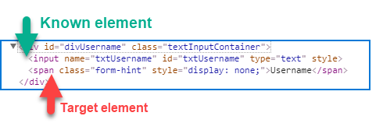
Locating following and following sibling
following
Keyword following-sibling:: can be used to locate the element(s) comes after to a known element within same HTML hierarchy.
Syntax:
//<xpathOfKnownElement>/following-sibling::<elementName> or
//<xpathOfKnownElement>/following-sibling::*
Example :
//*[@id=’txtUsername’]/following-sibling::span
//*[@id=’txtUsername’]/following-sibling::*

Slide 21
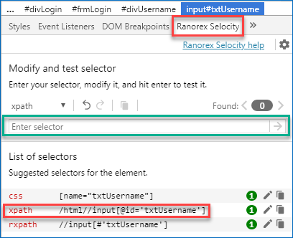
Validating and extracting XPath
It is important to ensure XPath used in your automation script is validated before running the script. Fixing the XPaths after running the test is expensive. There are many tools available to validate the correctness of the XPaths.
There are many browser plugins available for validating and extracting XPaths. We are using Ranorex Selocity for extracting XPath and validating the XPath syntax.
As example we’ll use Ranorex (Plugin for chrome):
Install Ranorex Selocity plugin from Chrome store
Navigate to your web page
Inspect the element
Select Ranorex Selocity in developer tool

Slide 22
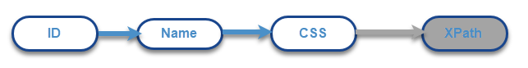
XPath or CSS
CSS and XPath are the most popular, widely used and powerful location strategies within the Selenium test automation community.CSS has gained wider acceptance from the test automation engineers due to following reasons. (People in favor of CSS says)
CSS more readable ( simpler )
CSS is faster (especially in IE)
Those who are in favor of XPath says about its ability to transverse around the page where CSS cannot. XPath can traverse up and down the DOM. CSS can traverse only down the DOM. These claims may be already outdated :-).
Some research demonstrates that there is no significant difference in speed. Mastering both of them is a good idea for the Selenium test automation engineers who wish to build their career around Selenium. It is better to a use single location strategy for a project for a number of reasons.
Some gurus advice a hybrid approach. They use ID and name first and moving to CSS. XPath is used only when it is required

Slide 23
Quick Reference
See the whole references on xpathreferences.xls
XPath | Note
//E[@id=’i’] | Element with id i
//*[@id=’i’] | Element(s) with id i
//E[@id=’n’] | Element with id n
//*[@id=’n’] | Element(s) with id n

Slide 24
Terminology
Word | Description
Root element | The top most element in XML document tree. It is html element in web pages.
Siblings | Nodes that have the same parent
Ancestors | Node’s parent, parent’s parent and so on.
Descendants | Node’s children, children’s children and so on
InnerHTML | The innerHTML property sets or returns the HTML content (inner HTML) of an element.
DOM | The HTML DOM is a standard for how to get, change, add, or delete HTML elements.

Slide 25
Reference
Arrgyle. 2016. Css Vs. X Path. [ONLINE] Available at: http://elementalselenium.com/tips/32-xpath-vs-css. [Accessed 21 August 2016].
Arrgyle. 2016. How To Verify Your Locators Without Selenium. [ONLINE] Available at:http://elementalselenium.com/tips/verifying-locators. [Accessed 21 August 2016].
CSS Selectors | Selenium Testing? Cross Browser Testing with Sauce Labs. 2016. CSS Selectors | Selenium Testing? Cross Browser Testing with Sauce Labs. [ONLINE]
Available at:http://sauceio.com/index.php/tag/css-selectors/. [Accessed 21 August 2016]
jquery – CSS selector case insensitive for attributes – Stack Overflow. 2016. jquery – CSS selector case insensitive for attributes – Stack Overflow. [ONLINE]
Available at:http://stackoverflow.com/questions/5671238/css-selector-case-insensitive-for-attributes. [Accessed 21 August 2016].
Sauce Labs. 2016. Selenium Tips: CSS Selectors | Sauce Labs . [ONLINE] Available at:https://saucelabs.com/resources/articles/selenium-tips-css-selectors. [Accessed 21 August 2016].
Selenium Easy. 2016. CSS selectors for Selenium with example | Selenium Easy. [ONLINE] Available at:https://www.seleniumeasy.com/selenium-tutorials/css-selectors-tutorial-for-selenium-with-examples. [Accessed 21 August 2016].
Selectors Level 3. 2016. Selectors Level 3. [ONLINE] Available at: https://www.w3.org/TR/css3-selectors/. [Accessed 21 August 2016].
Saurabh Gupta. 2016. Quick Reference for Xpath and CSS locators – Selenium WebDriver. [ONLINE] Available at: https://www.linkedin.com/pulse/quick-reference-xpath-css-locators-selenium-webdriver-saurabh-gupta. [Accessed 21 August 2016].
Testing Excellence. 2016. CSS Selectors in Selenium WebDriver with Examples. [ONLINE] Available at:http://www.testingexcellence.com/css-selectors-selenium-webdriver-tutorial/. [Accessed 21 August 2016].
Sauce Labs. (2018). Selenium Tips: CSS Selectors. [online] Available at: https://saucelabs.com/resources/articles/selenium-tips-css-selectors [Accessed 31 May 2018].
Pragmatictestlabs.com http://pragmatictestlabs.com/2018/05/31/mastering-css-for-selenium-test-automation-2/

Slide 26
Adelquis trinidad
engineer
Adelquis.Trinidad@endava.com

